Slide 1
Perturbing, and visualizing cells
Chapter 9

Slide 2
Visualizing cells
Chapter 9

Slide 3
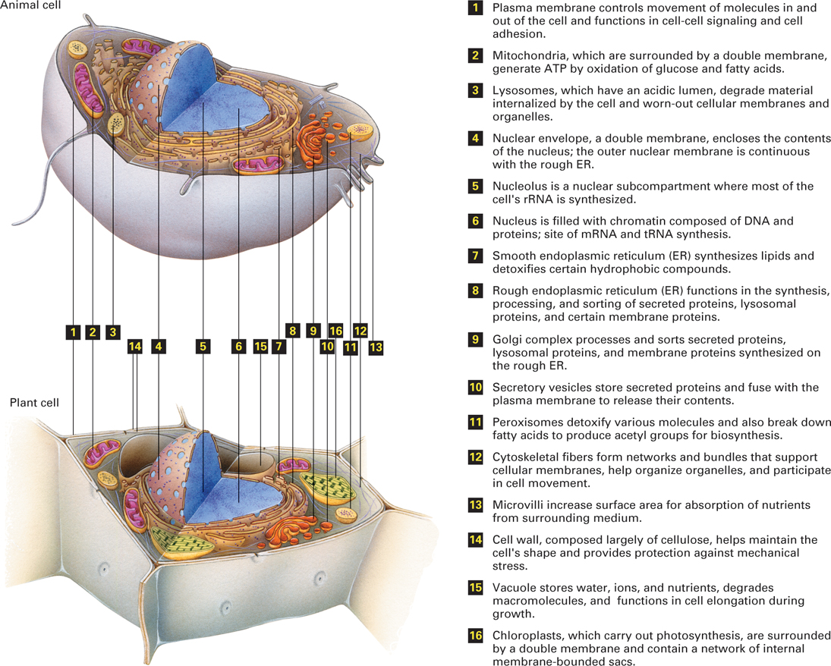
Figure 9.32 Schematic overview of a “typical” animal cell (top) and plant cell (bottom) and their major substructures.

Slide 4
FLUORESCENCE MICROSCOPY

Slide 5
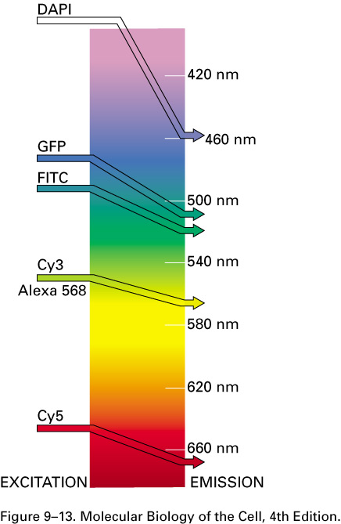
What is fluorescence?
Absorb light at one wavelength and emit light at a specific and longer wavelength

Slide 6
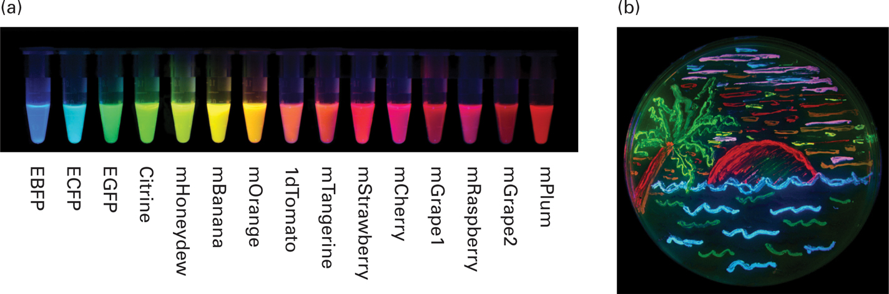
Fluorescent colors that are available

Slide 7
Fluorescence Microscopy
Major Function: Localization of specific cellular molecules – example proteins
Expression of fluorescent proteins – recombinant DNA technology.
Major Advantages:
Sensitivity:“glow” against dark background
Specificity: immunofluorescence
Cells may be fixed or living
Fluorescent dyes or proteins (Flurochromes)
flurochromes may be indirectly or directly associated with the cellular molecule
Multiple flurochromes may be used simultaneously

Slide 8
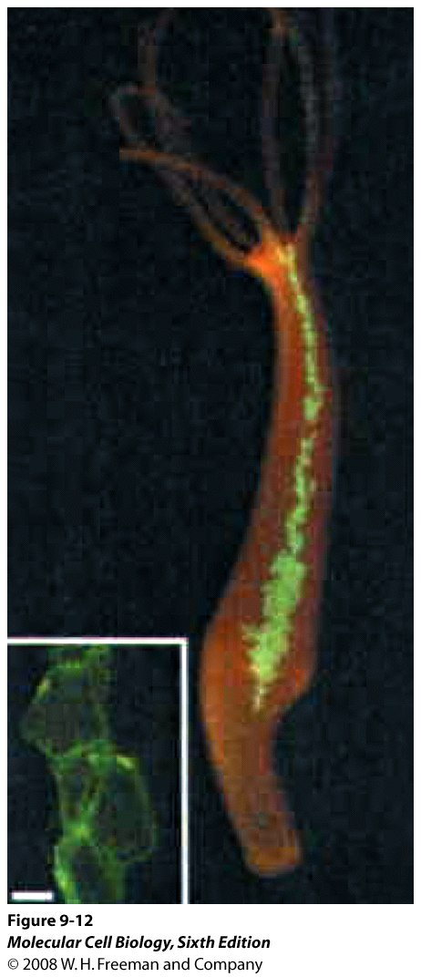
HYDRA EXPRESSING GFP
Fluorescent protein in live cells
Plasmid containing the GFP gene is driven by the H.vulgaris beta-actin promoter.
GFP – green fluorescent protein ( jelly fish)
Notes:
Fura-2

Slide 9
RECOMBINANT DNA TECHNIQUE TO TAG PROTEINS WITH GFP FOR VISUALIZATION IN LIVING CELLS
Gene of interest X is fused with GFP gene
This recombinant DNA is transfected (introducing foreign DNA into eukaryotic cells) into living cells.
Wait for protein expression
Chimeric fusion protein (Protein X-GFP) can be visualized in living cells
Very useful in studying protein localization.

Slide 10
Immunofluorescence Microscopy of Specific Proteins in FIXED CELLS
Fluorescently tagged primary anti body
Commonly used fluorochromes include Texas red, and rhodamine (emit red light), Cy3 (emits orange light), fluorescein (emits green light).
Fluorescently tagged secondary antibody- Indirect Immunofluorescence microscopy
Fluorescently labelled antibody to tagged proteins such as myc or FLAG
Fluorescent dye fura-2 used to monitor Ca2+ concentrations within the cell
SPED (stimulated emission depletion) fluorescence microscopy has a resolution of 20nm.

Slide 11
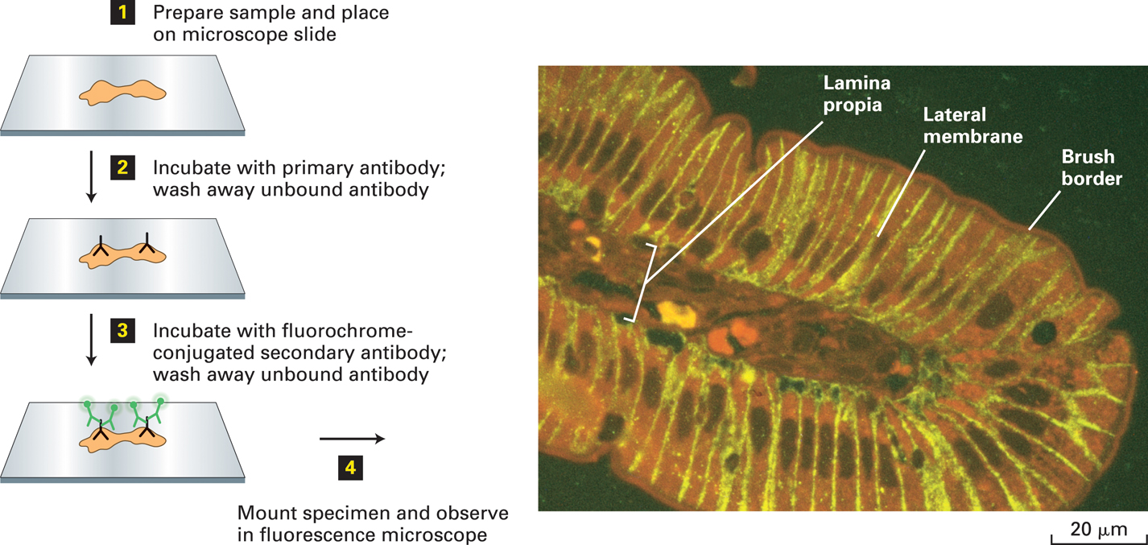
RAT INTESTINAL CELL WALL – GLUT 2 Purpose- to visualize the localization of Glucose Transporter 2

Slide 12
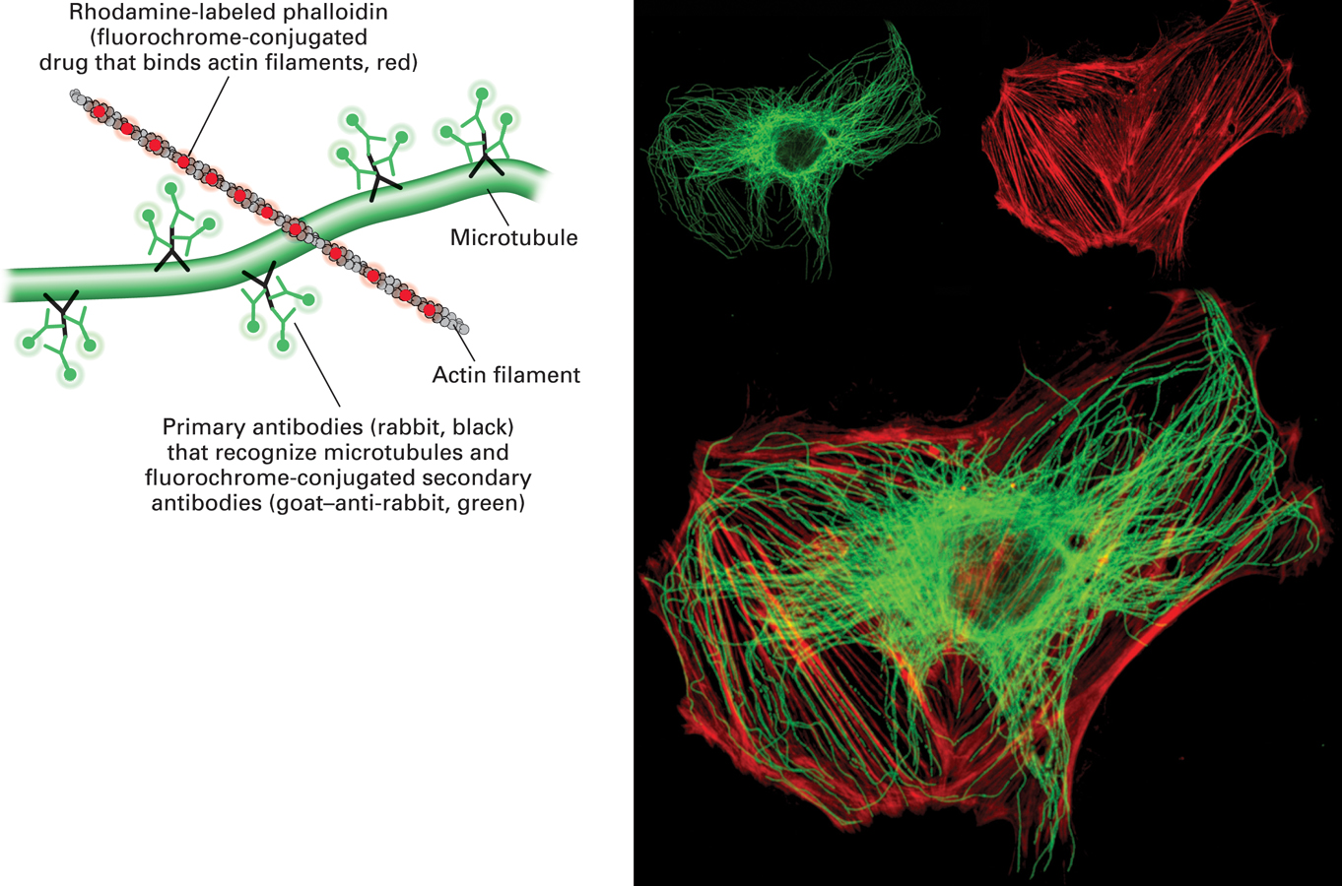
Tagging with fluorescent tags/proteins allows visualization of specific proteins Double-label fluorescence microscopy can visualize the relative distributions of two proteins.

Slide 13
CONFOCAL AND DECONVOLUTION MICROSCOPY
This overcomes the limitations of Fluorescence microscopy
Blurred images
Thick specimens
CONFOCAL MICROSCOPY
- Laser as the energy source
- The laser scans the specimen across and down to build the image
- Uses a pinhole in front of the detector so light from other focal planes are blocked

Slide 14
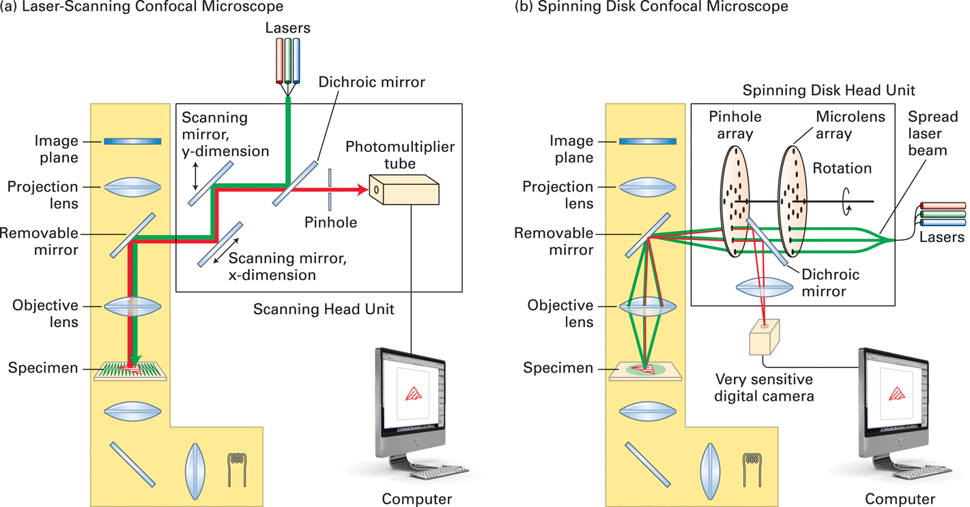
Figure 9.17 Light paths for two types of confocal microscopy.

Slide 15
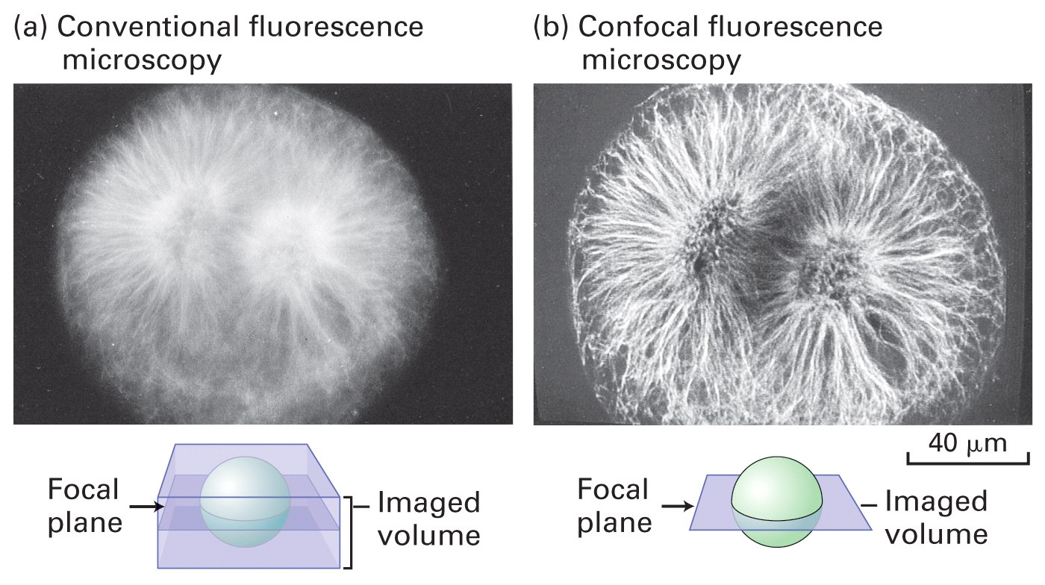
REMOVES OUT OF FOCUS IMAGES
Sea Urchin egg undergoing mitosis – using fluorescein-tagged secondary antibody that binds to primary anti-tubulin antibody

Slide 16
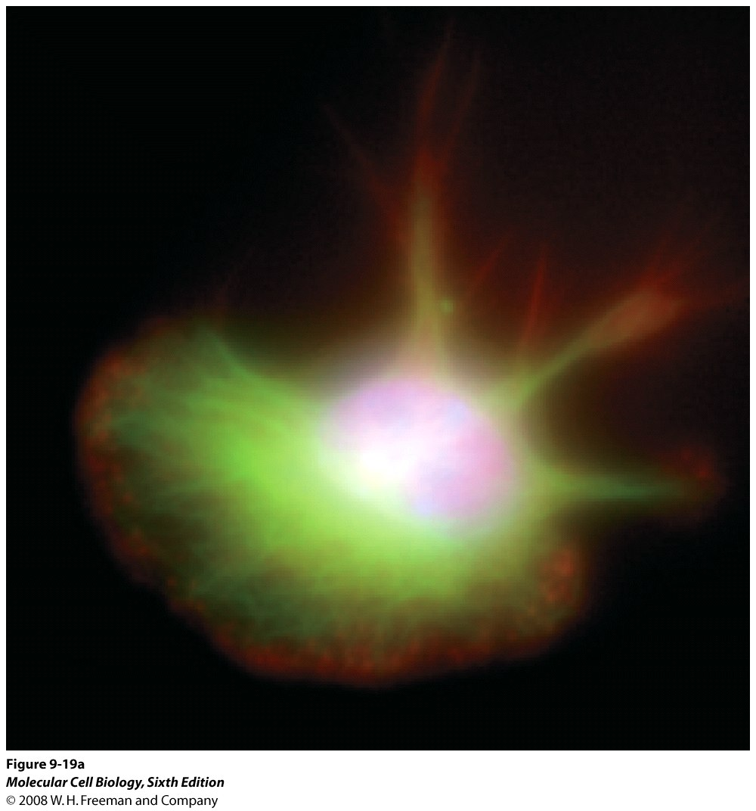
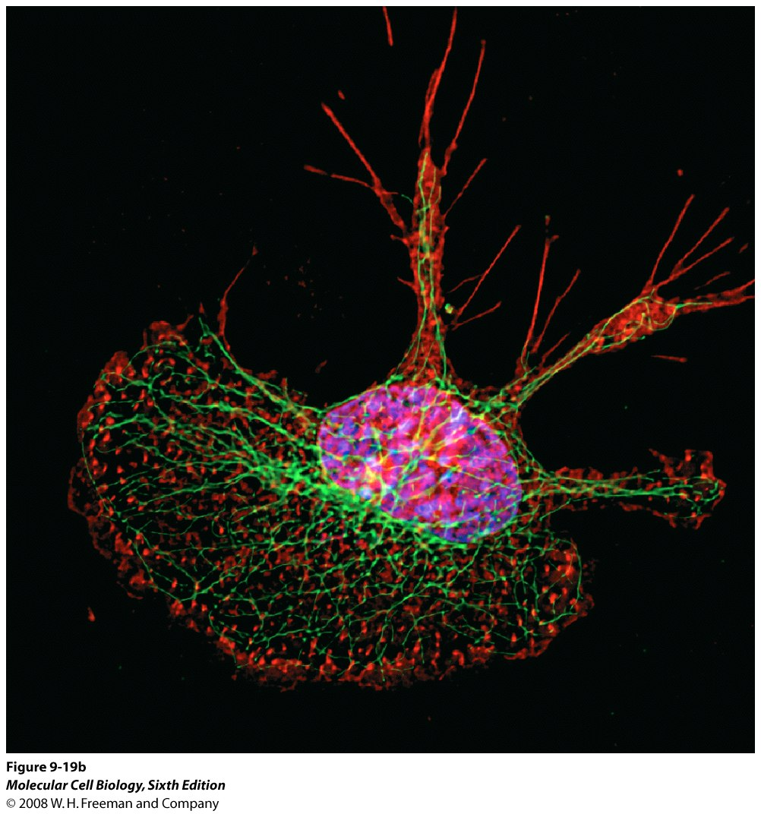
EXAMPLE OF IMAGE RECONSTRUCTED AFTER DECONVOLUTION MICROSCOPY
DNA – blue, Microtubules – green and Actin microfilaments - red

Slide 17
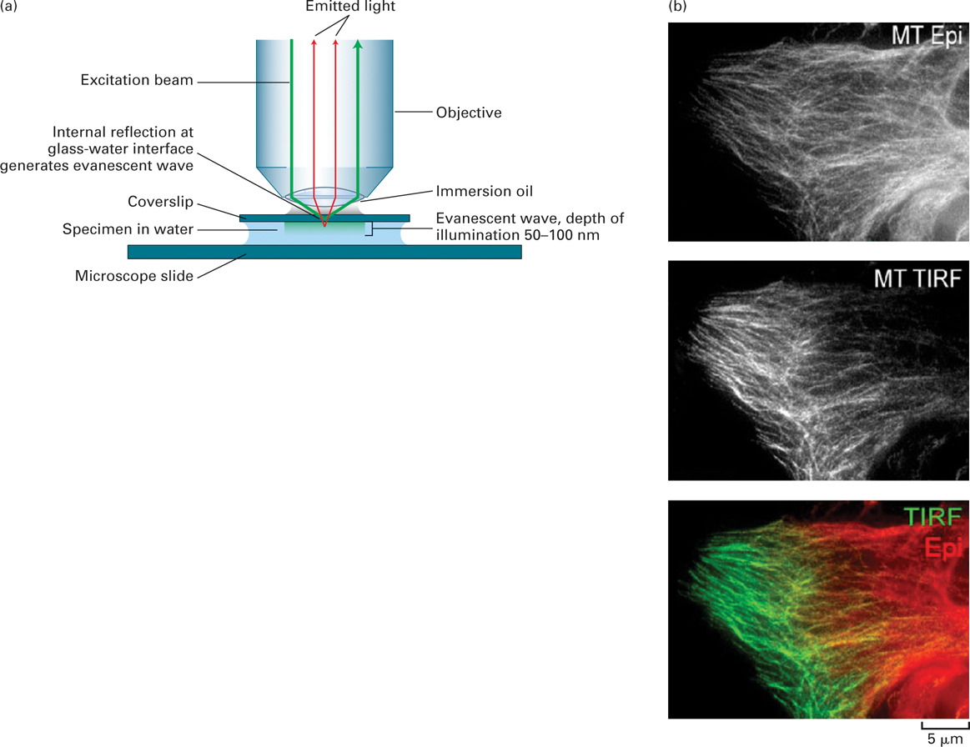
Fluorescent samples in a restricted focal plane can be imaged by total internal reflection (TIRF) microscopy.
Used for imaging in a thin focal plane

Slide 18
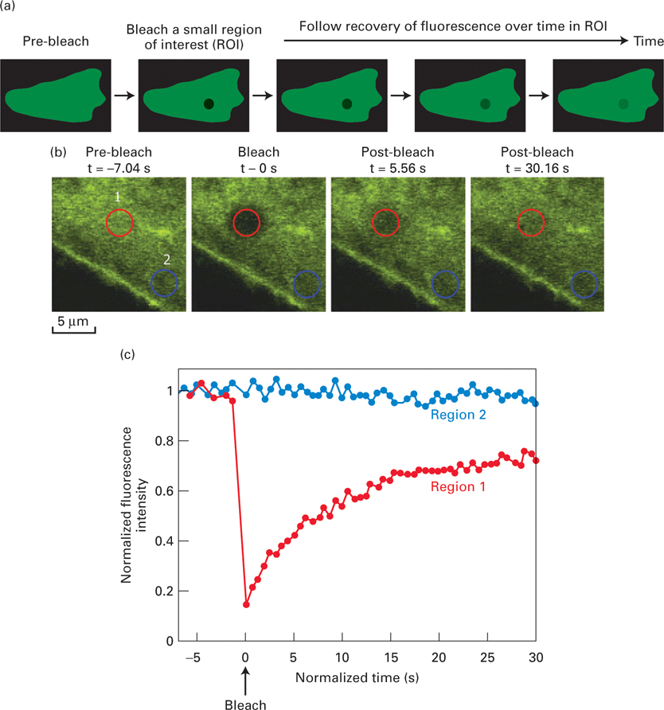
FRAP shows dynamics of cellular components Fluorescence recovery after photobleaching (FRAP) reveals the dynamics of molecules.

Slide 19
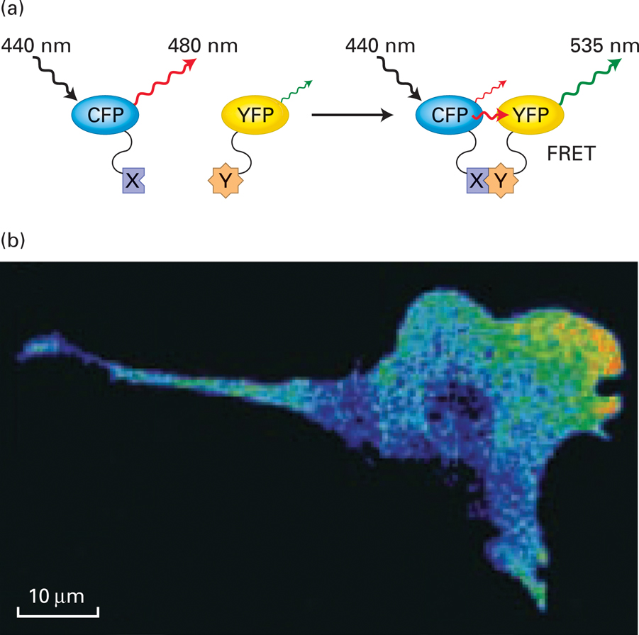
FRET measures distance between porteins using chromophores Protein-protein interactions can be visualized by FRET.

Slide 20
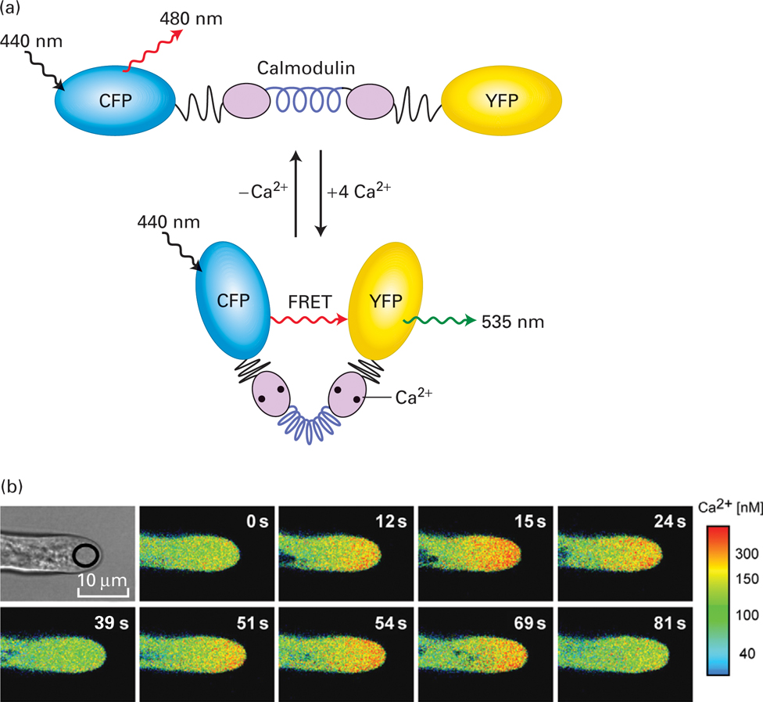
FRET biosensors can detect local biochemical environments.

Slide 21
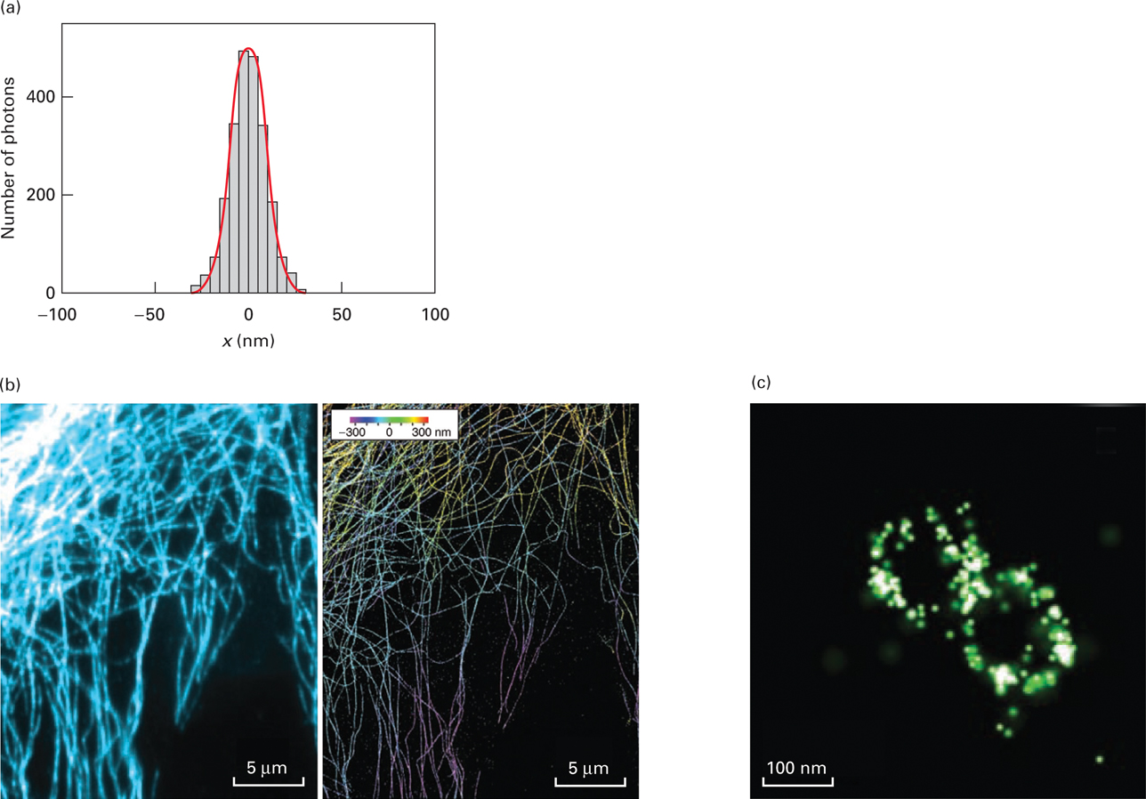
Super-resolution microscopy can generate light-microscope images with nanometer resolution.
Overcomes resolution limitations of
Fluorescence microscopy .
Clathrin-coated pit by super-
resolution
Confocal
Super-resolution
3-D structure of microtubues

Slide 22
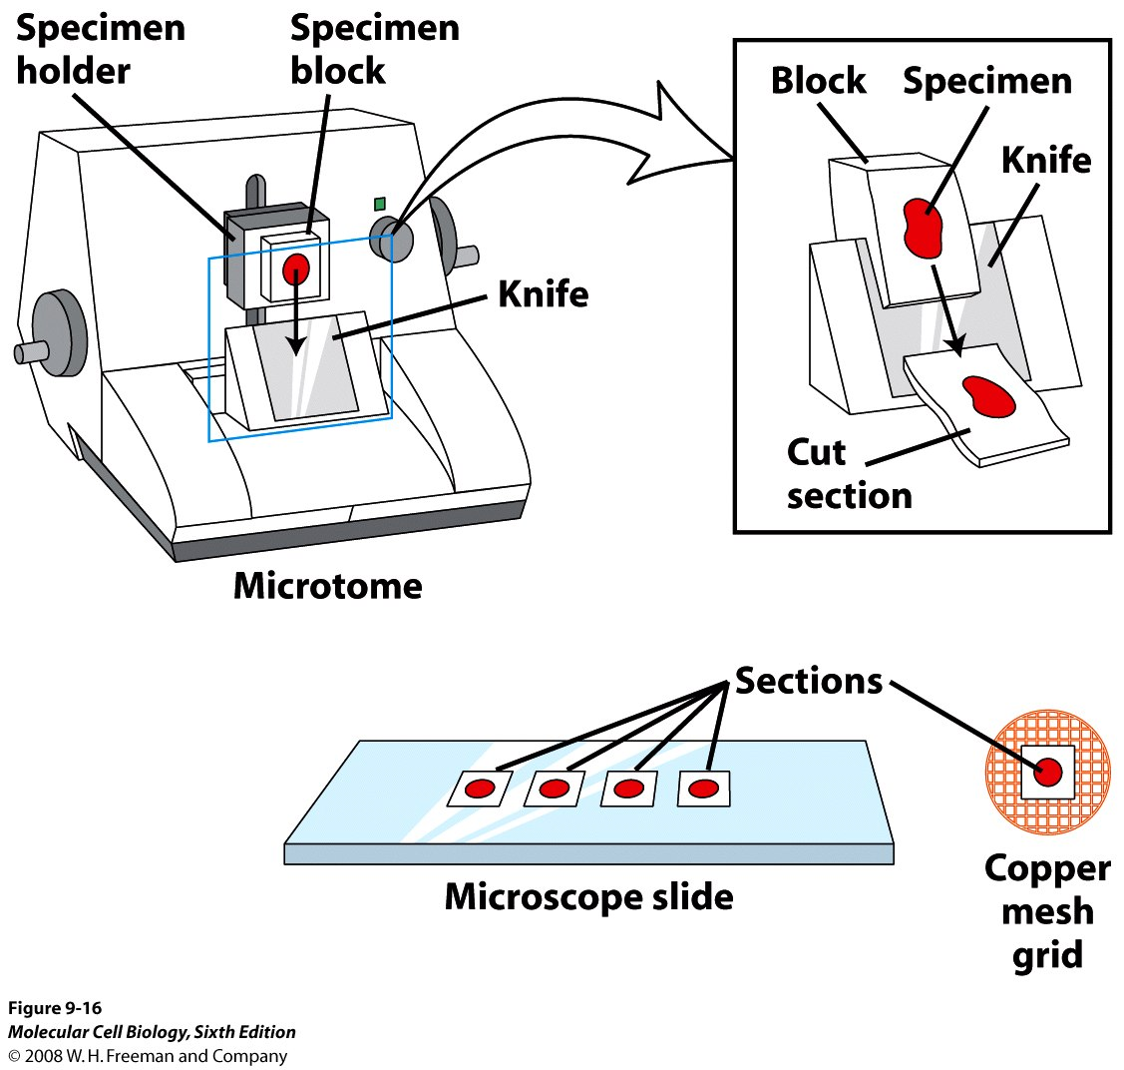
SPECIMEN PREPARATION FOR BOTH LIGHT AND ELECTRON
MICROSCOPY
FIX –Formaldehyde cross links amino groups on adjacent molecules
EMBED – For light microscopy in Paraffin; For electron microscopy in liquid plastic
SECTION – 0.5- 50 micrometers for Light microscopy; 50 -100 nm for electron microscopy
STAIN – Hemotoxylin binds to basic amino acids and eosin binds to acidic molecules
For Cryo EM, the samples can be frozen without fixation and then sectioned.

Slide 23
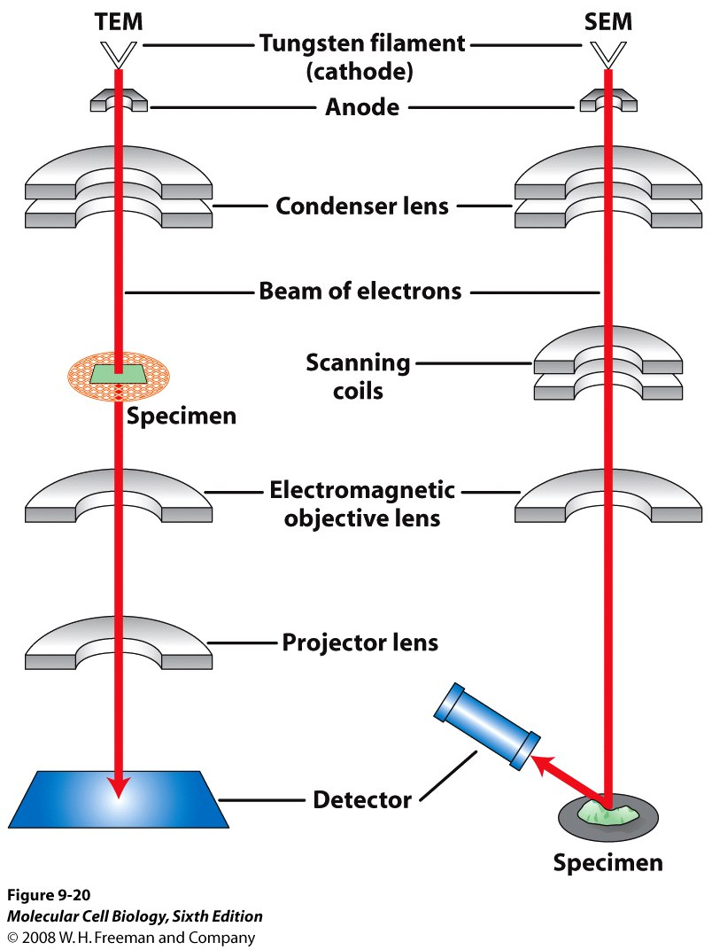
ELECTRON MICROSCOPY

Slide 24
Transmission EM
theoretically 0.005 nm; practically 0.1 nm –1 nm (2000x better than LM)
High – velocity electron beam passes through the sample
50-100 nm thick sections
2-D sectional image – surface details are revelaed
Subcellular organelles
Samples need to be fixed and stained and so cannot image living cells
Stained with heavy metals such as uranium, lead, Osmium tetroxide (stains membranes)
Scanning EM
Resolution about 10 nm
Used to view unsectioned, metal coated specimens
3-D surface image

Slide 25
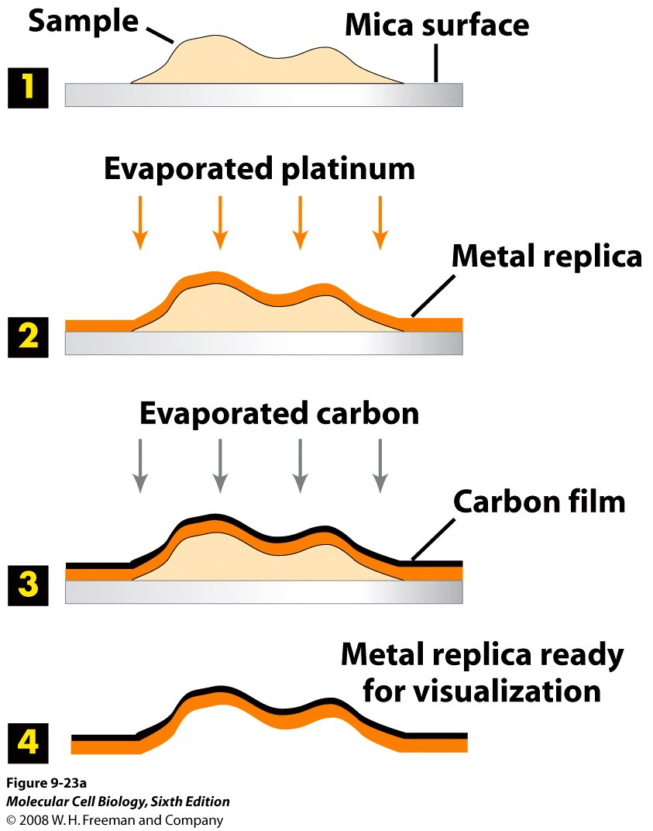
SURFACE DETAILS BY METAL SHADOWING in TEM

Slide 26
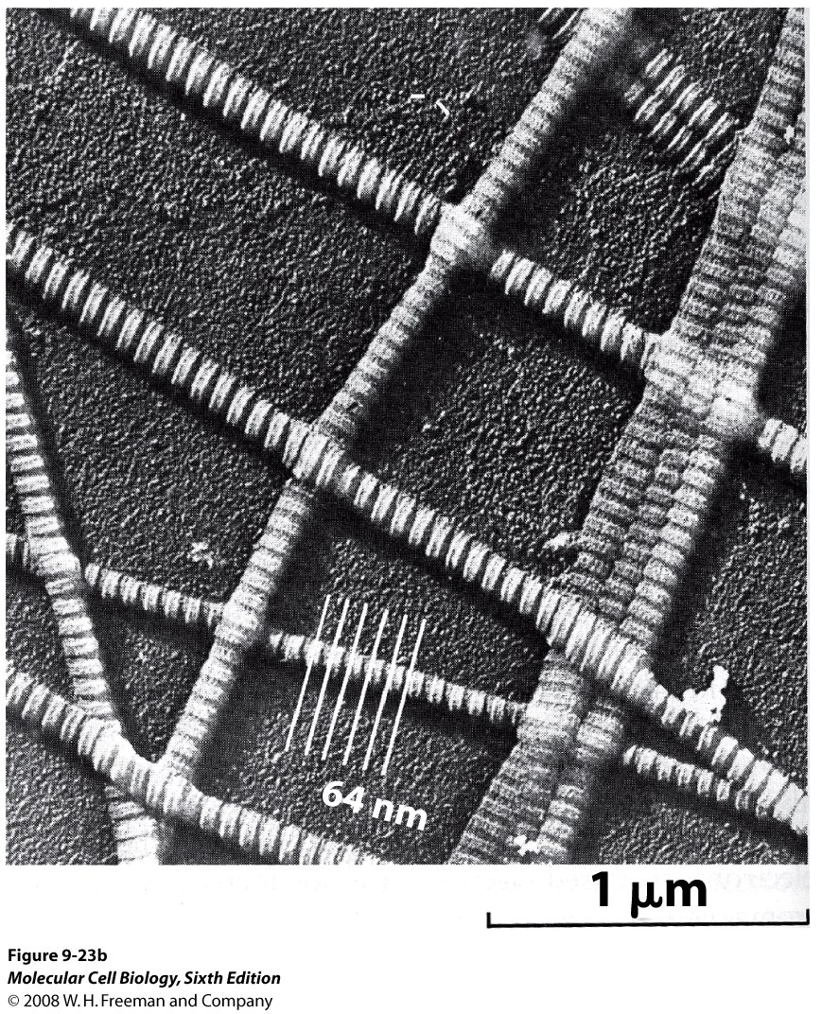
PLATINUM SHADOWED REPLICA OF THE SUBSTRUCTURAL FIBERS OF CALFSKIN COLLAGEN

Slide 27
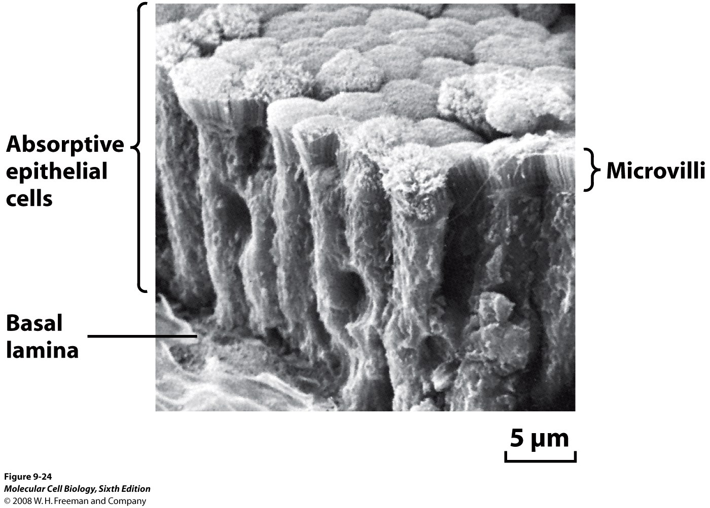
SEM OF EPITHELIUM LINING THE INTESTINAL LUMEN

Slide 28
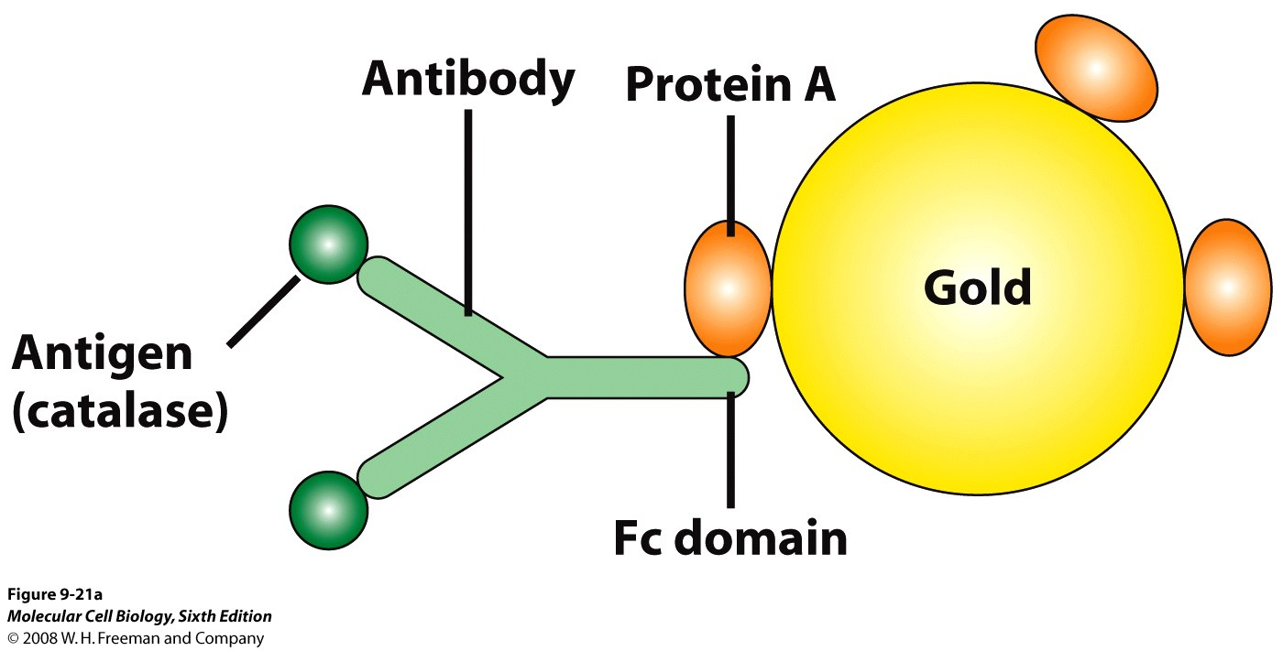
GOLD PARTICLES COATED WITH PROTEIN A ARE USED TO DETECT ANTIBODY BOUND TO PROTEIN
Protein A binds to the Fc segment of all antibody molecules

Slide 29
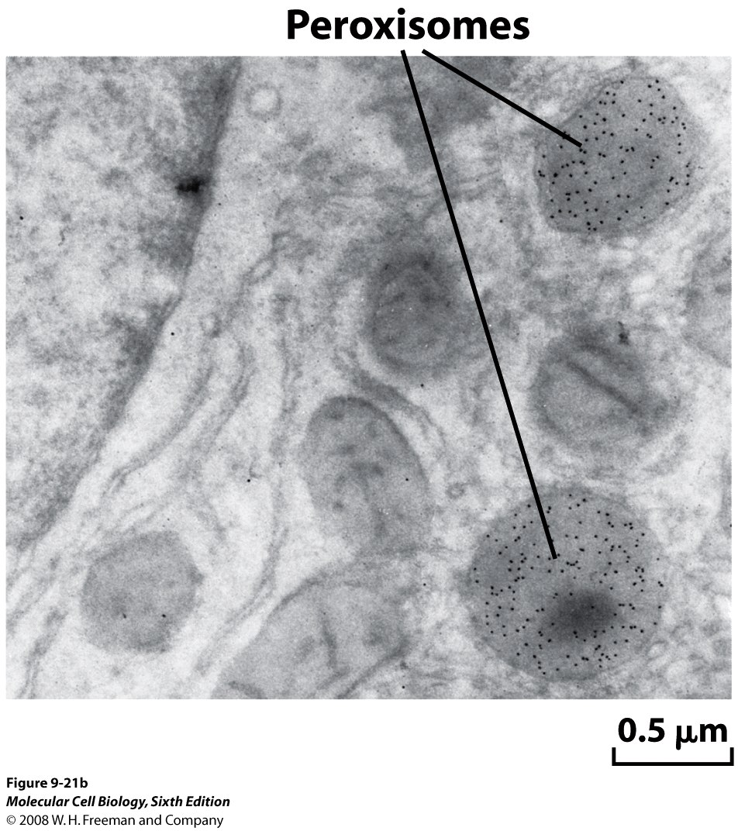
TEM IMAGE
Purpose: To visualize catalase
Method:
A slice of rat liver fixed with glutaraldehyde, sectioned and then treated to visualize catalase molecules.
Conclusion: Black dots indicate localization of catalase only in peroxisomes.

Slide 30
CRYOELECTRON MICROSCOPY
HYDRATED, UNFIXED AND UNSTAINED SAMPLES
SAMPLES ARE OBSERVED IN ITS NATIVE HYDRATED STATE
METHOD - AN AQUEOUS SUSPENSION OF SAMPLE IS APLLIED ON A GRID (frozen in liquid nitrogen) AND HELD BY A SPECIAL MOUNT
5 nm RESOLUTION
Variation of this is CRYOELECTRON TOMOGRAPHY. This allows determination of 3D structure .

Slide 31
Perturbing cells to study organelles

Slide 32
PURIFICATION OF CELL ORGANELLES
CELL DISRUPTION –in isotonic solution
SEPARATION OF DIFFERENT ORGANELLES USING CENTRIFUGATION
PREPARATION OF PURIFIED ORGANELLES USING SPECIFIC ANTIBODIES

Slide 33
BREAKING OPEN PLASMA MEMBRANES IN CELLS
CELLS ARE SUSPENDED IN ISOTONIC SUCROSE AFTER
SONICATION
HOMOGENIZATION
CELLS IN HYPOTONIC SOLUTION – RUPTURE OF CELL MEMBRANES

Slide 34
SEPERATING ORGANELLES
DIFFERENTIAL CENTRIFUGATION
DENSITY GRADIENT CENTRIFUGATION

Slide 35
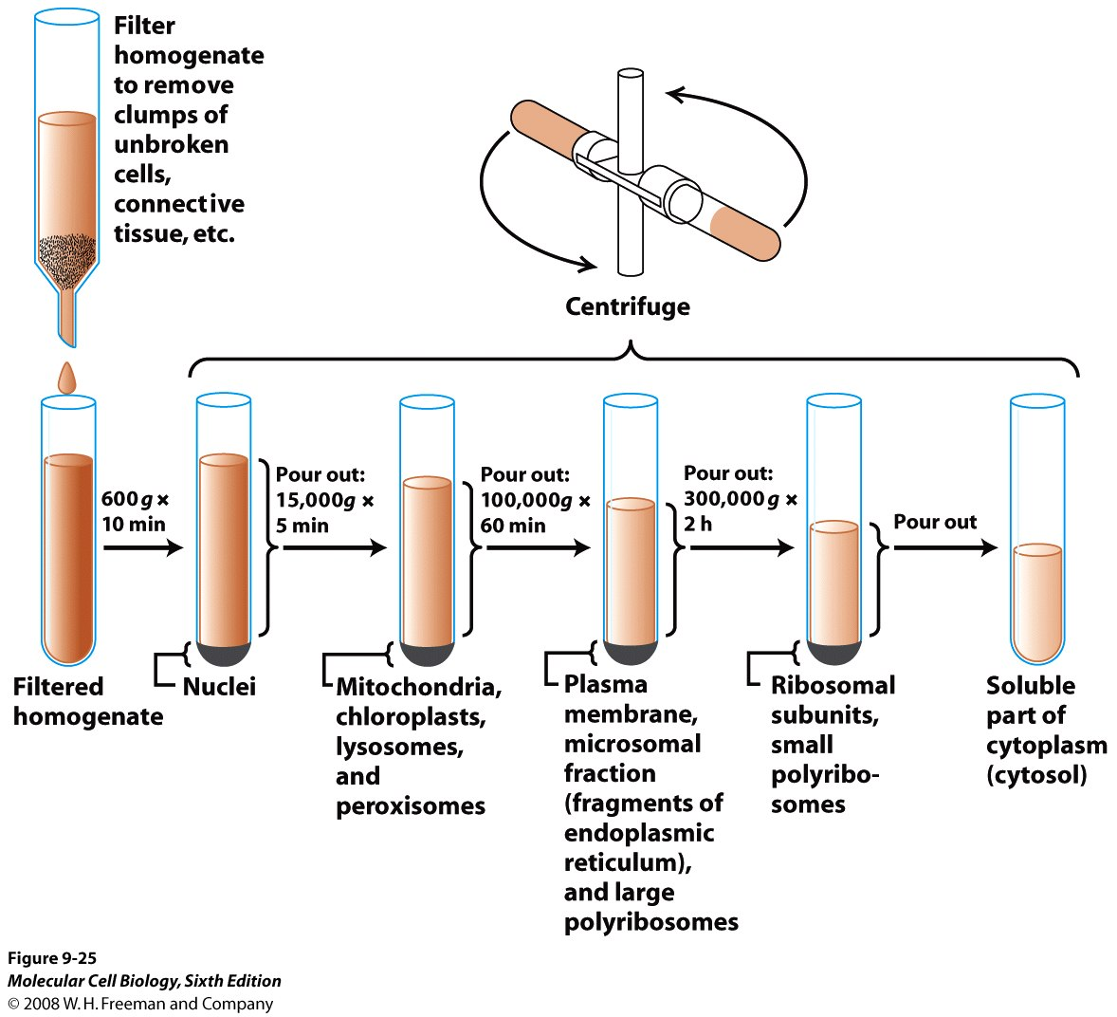
DIFFERENTIAL CENTRIFUGATION

Slide 36
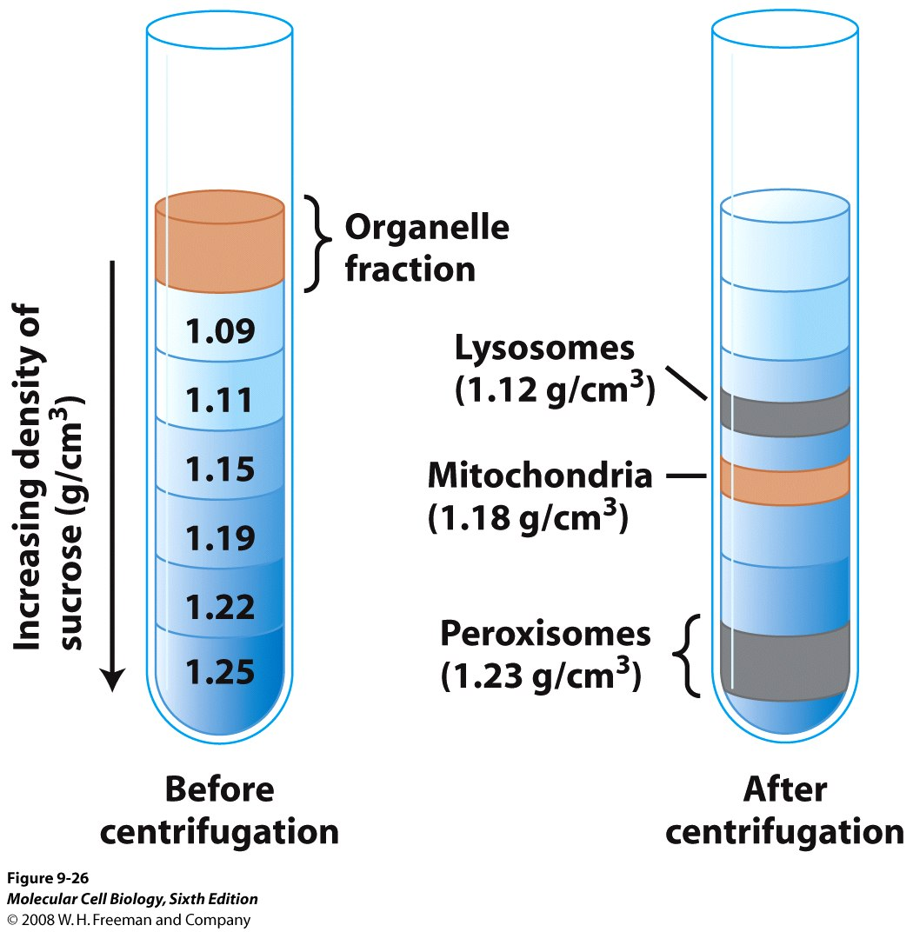
DENSITY GRADIENT CENTRIFUGATION

Slide 37
PURIFICATION OF ORGANELLE FRACTION USING SPECIFIC ANTIBODIES
CATALASE – PROXISOMES
CYTOCHROME C – MITOCHONDRIA
ACID PHOSPHATASE – LYSOSOMES
The proteins listed above are specific for each organelle. Western blots of protein fractions are probed with antibodies specific to the proteins of interest. Cross contamination of organelle fractions is tested as mentioned in class, by analyzing the western blot results.

Slide 38
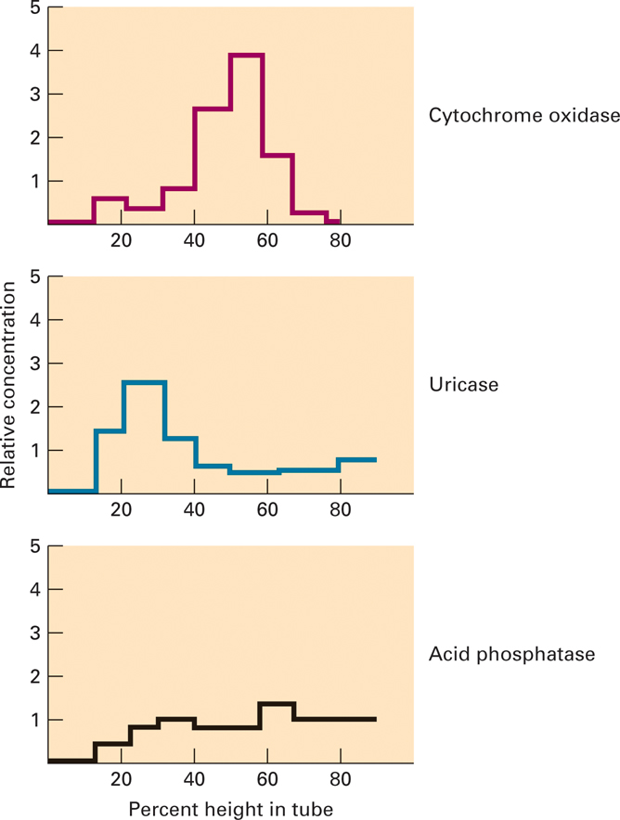
CLASSIC EXPERIMENT 9.1 Figure 1 Graphical representation of the enzyme analysis of products from a sucrose gradient.

Slide 39
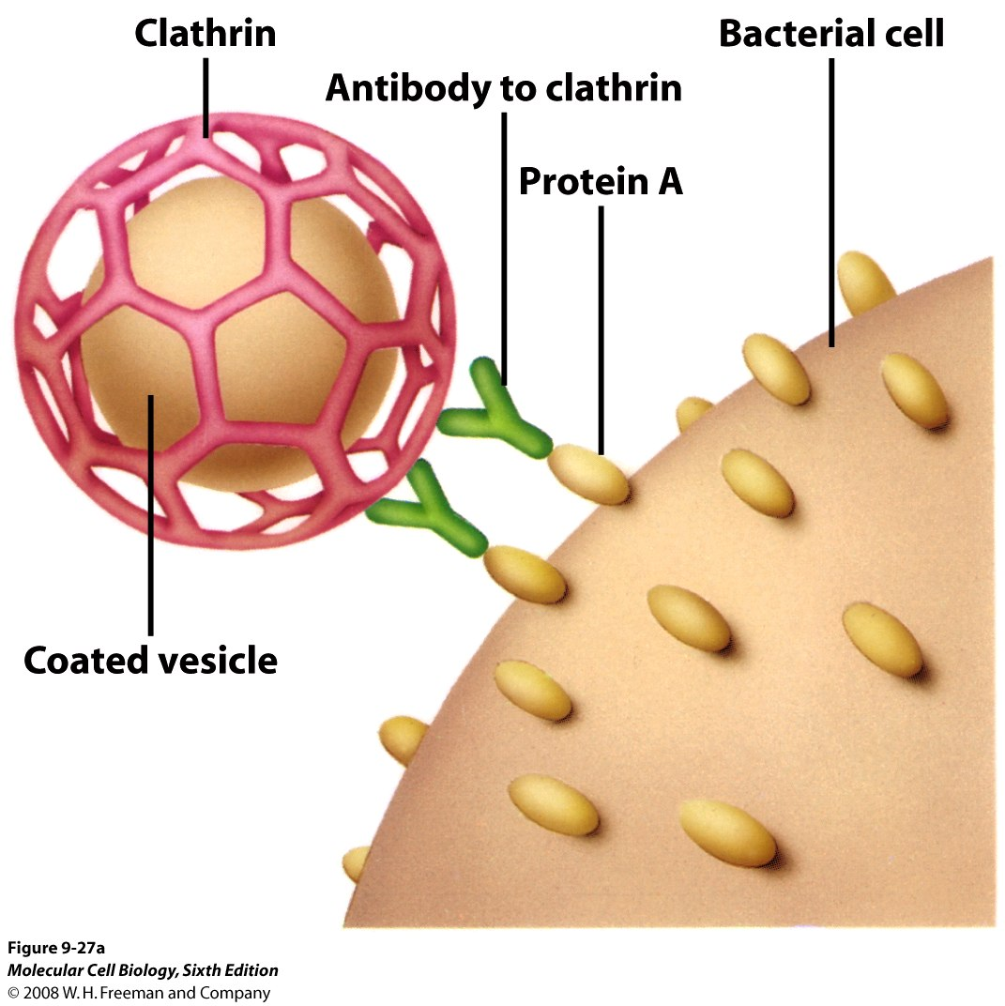
ANTIBODIES ARE USED TO MAKE PURIFIED VESICLES
Antibodies against organelle-specific proteins are used.

Slide 40
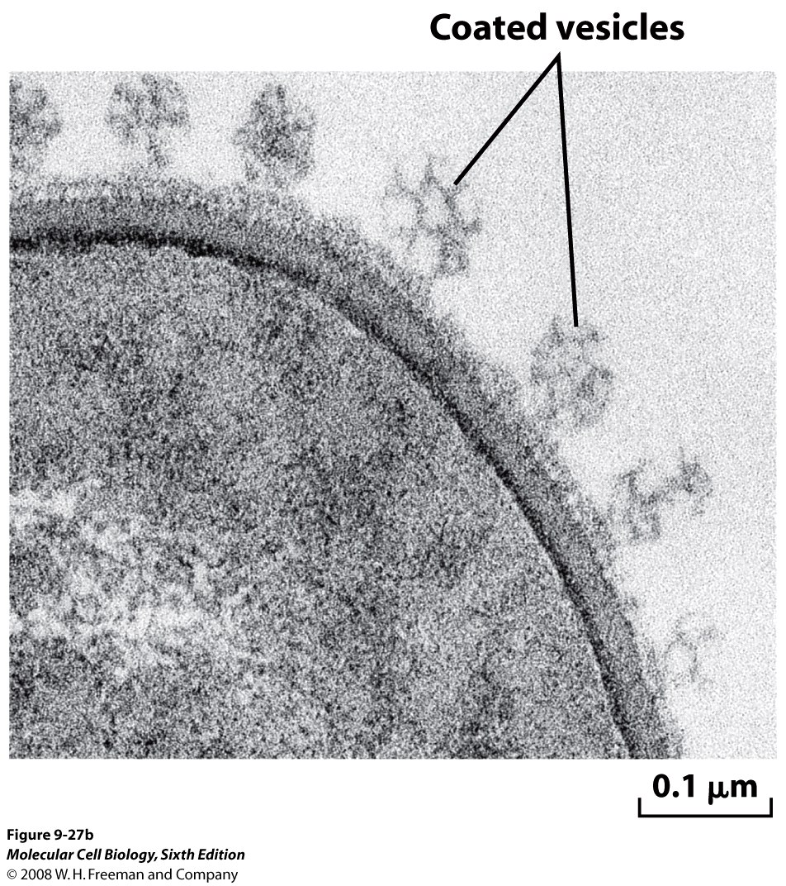
Membrane suspension from Rat liver is incubated with antibody to clathrin.
Staphylococcus Aureus bacterial suspension is added to the mix.
S.Aureus membrane contains Protein A

Slide 41
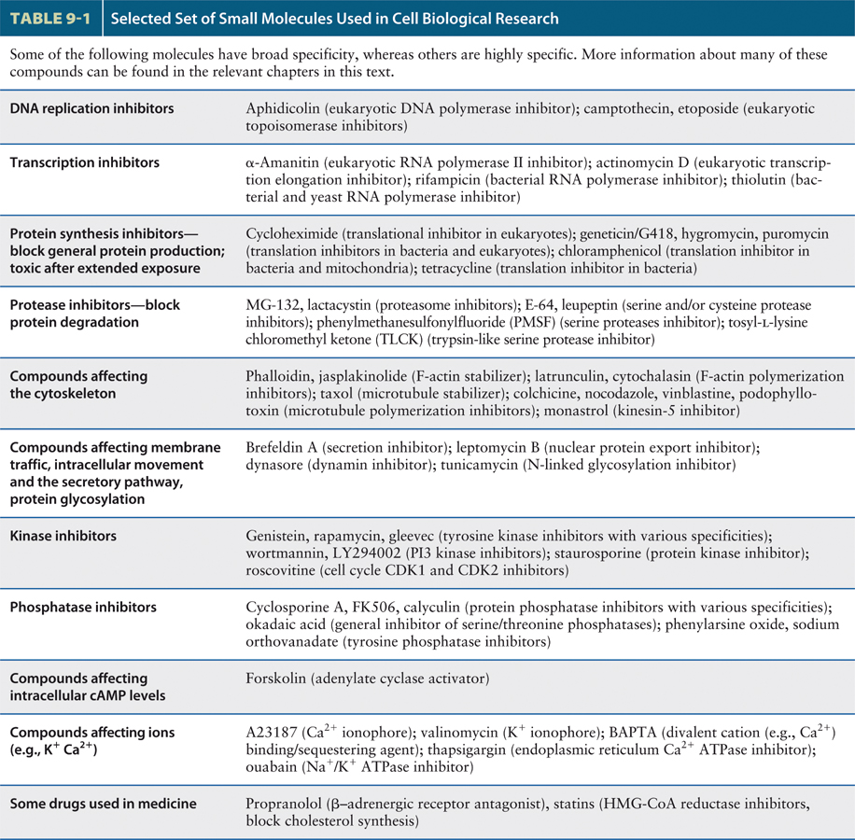

Slide 42
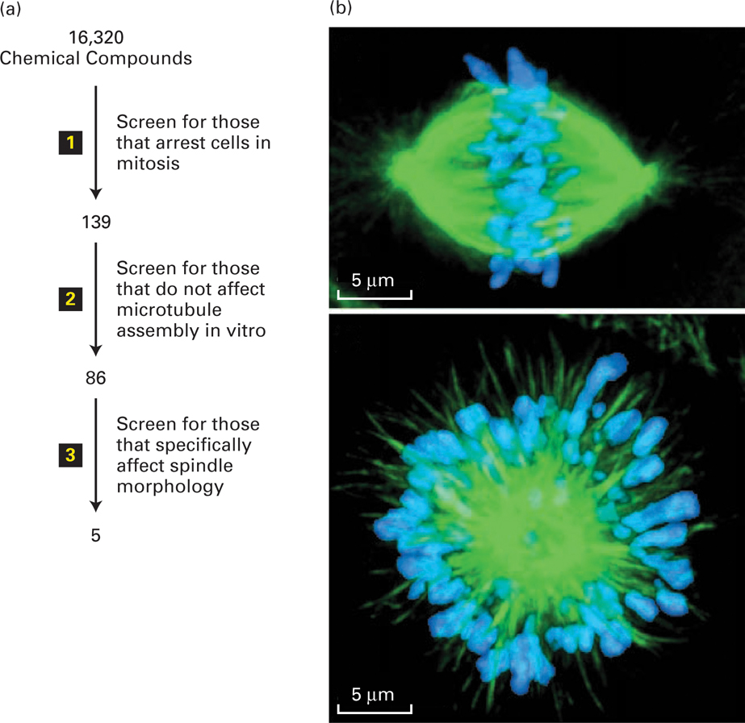
Screening for drugs that affect specific biological processes.

Slide 43
siRNA – methods and analysis

Slide 44
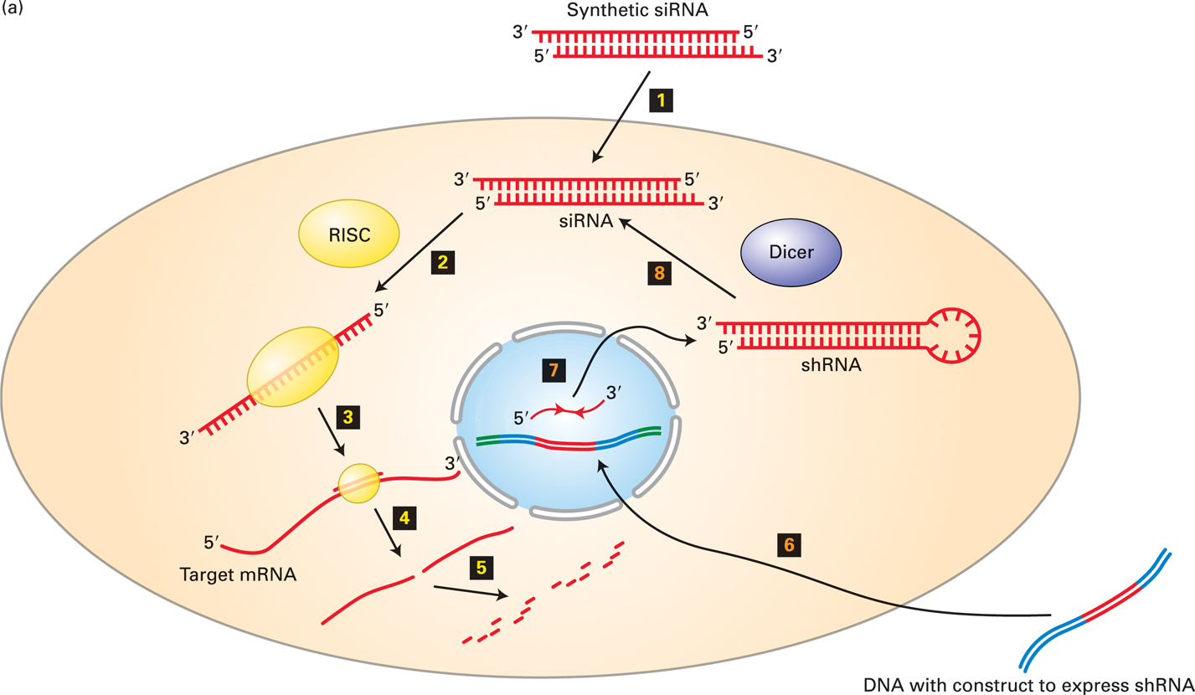
SMALL INHIBITORY RNA (siRNA) can knock down specific protein expression siRNA or DNA expressing shRNA can target the degradation of specific mRNAs in cultured cells.
RISC – RNA induced silencing complex
Dicer – an RNA endonuclease
that has dicer activity against dsRNA. This cleaves the loop region

Slide 45
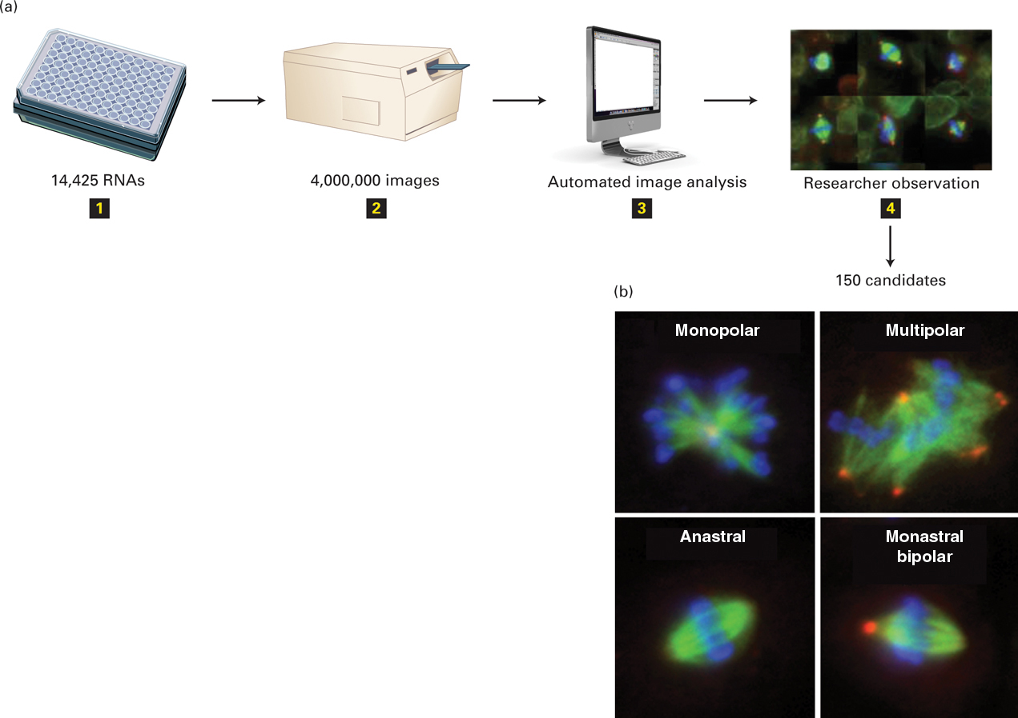
Genomic screens using siRNA RNAi screens can explore the function of all the genes in cultured cells.

Slide 46
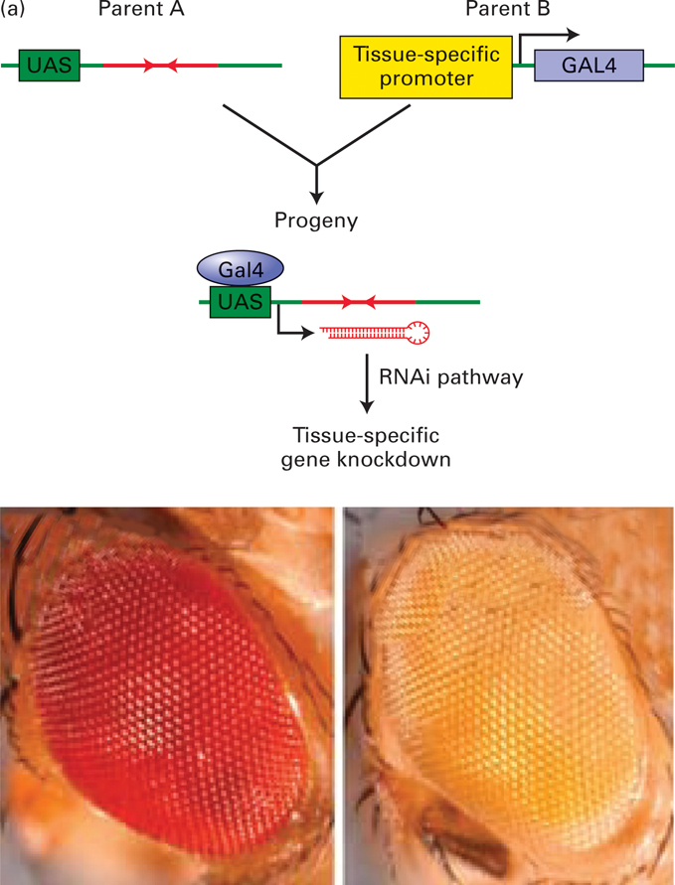
RNAi can be used to suppress genes in a tissue-specific manner in the fruit fly.

